Slide 1
Excel bitesize 1 – Managing your data
Discover. Learn. Analyse. Shape. Repeat
Be more datawise
#DatawiseLondon

Slide 2
Session agenda
10:00 Intros
10:10 Zoom controls & session guidelines
10:15 Demo & Short exercises
11:20 Wrap up & questions

Slide 3
Introductions
We’re going to keep intros quick as this is a short session with lots to cover so please tell us:
Your name
Something that drives you mad when trying to use Excel
or
Use one word to describe how you feel about Excel
Notes:
10 mins: less than 1 min per participant. Alice or Antonia to give an example of something that drives them mad (ideally something which we cover in this session!!

Slide 4
Zoom controls
Alt+Tab or Command+Tab to toggle between Excel & Zoom

Slide 5


More zoom controls…..
Exit full screen to move easily between windows
Change video view options to hide or minimise when looking at slides. Click and drag on the video box to move around the screen

Slide 6
How we’ll run the training:
Session will be divided up into a short topic demo & then the opportunity for you to put it into practice. Please don’t start trying to do the exercise during the demo, you’ll have plenty of time to do it afterwards
Questions – ask questions either in chat function (which I’ll check during exercises) or out loud at the end of a topic before we do the exercise
Step by step guidelines have been emailed to you – use them if you get stuck (but try to resist!)
Please keep your camera & microphone on unless you have a noisy background
Polling – we’re going to be using polling throughout the session for quizzes

Slide 7







Notes:
3 mins: Quick explanation of Datawise London. We will send slide so you can check them all out – all have masses of helpful information, training, one to one sessions available for free or very cheaply for charities. Ask Antonia to give a 1 min into to COE

Slide 8
What we’ll cover today…
Understanding the Excel ribbon & what's available
Working with Excel sheets (adding, moving, renaming, colour coding & framing)
Adding & formatting tables
Calculated columns and totals
Sorting & filtering data
Adding slicers (visual filters)
Highlighting duplicates (extension topic)
Printing
Make sure you have your Excel file downloaded!

Slide 9
Topic 1:Working with Excel
Understanding the ribbon
Getting help
Correcting mistakes
Different versions of Microsoft Excel

Slide 10
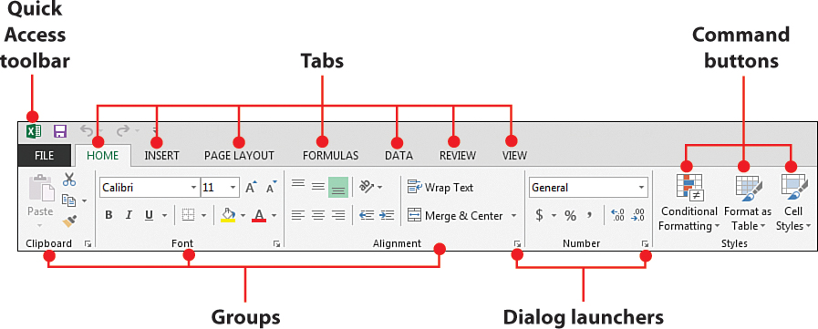
Understanding the ribbon

Slide 11
Today’s data
Music Mentors work with young offenders in prisons. People sign up to take part in group sessions where they work together with other offenders and mentors to write, play and record music. ​​
​
​
The data we are using today is fictional data for the programme which we have created for training purposes.

Slide 12
Topic 2: Viewing Spreadsheets
Format tabs
Freeze panes
Unfreeze panes
Hide columns
Unhide columns
Wrap text
Resize columns

Slide 13
Exercise for topic 2: Viewing Spreadsheets
Rename Sheet 1 to “Participants“
Make the tab green
Move the “Participants” tab to after the “Mentors" tab
Freeze the top row of the sheet
Hide the Welfare session attended column
Wrap the text in the Musical Experience column
Resize all the columns so that they are as wide as the column headings
Time for completion: 5 mins

Slide 14
Topic 3: Managing Data with tables
Making your data into a table
Naming the table
Formatting the table
Adding a calculated column
Adding a total row

Slide 15
Advantages of using tables in Excel
  Quick Styles
  Add colour, banded rows, and header styles with just one click to style your data.
  Table Names
  Give a table a name to make it easier to reference in other formulas.
  Cleaner Formulas
  Excel Formulas are much easier to read and write when working in tables.
  Auto Expand
  Add a new row or column to your data, and the Excel table automatically updates to include the new cells.
  Filters & Subtotals
  Automatically add filter buttons and subtotals that adapt as you filter your data.
  Calculated columns Enter a single formula in one cell, and then that formula will automatically expand to the rest of the column by itself.
  Dynamic Pivot tables
  If you use an Excel Table for the source data of your pivot table, the data range becomes "dynamic". A dynamic range will automatically expand and shrink the table as you add or remove data, so won't have to worry that the pivot table is missing the latest data. When you use a Table for your pivot table, the pivot table will always be in sync with your data.

Slide 16
Exercise for topic 3: Managing Data with Tables
Rename sheet 2 "Attendance"
Make the data on the Attendance tab into a table
Name the table "Attendance“
Format the table to make it a different colour
Use Auto Sum to work out how many people attended in total each month
Add total row to see total number of people who attended over the whole period
Answer the 2 questions in the Zoom poll
Time for completion: 6 minutes

Slide 17
Topic 4: Sorting & Filtering
Single level sorting
Multi-level sorting
Clearing a sort order
Filtering (select & deselect)
Filtering (Text filters)
Data slicers

Slide 18
Exercise for topic 4: Sorting & Filtering
Make the data in the Participants sheet into a table & call it “Participants”
Sort by Prison (A-Z) & Name (A-Z)
Add a text filter on the Musical Instrument column so that only rows
which contain the word “piano” are displayed. How many rows is
this (answer in the Zoom poll)
Clear the filter
Add a slicer for Prison. Answer the zoom poll how many people
attended from HMP Holloway?
Completion time: 6 mins

Slide 19
Topic 5: Printing
Scale to fit a worksheet on to page
Add a custom header & footer

Slide 20
Exercise for Topic 5: Printing
On the Participants tab select Print
Change the page layout to landscape
Scale the page to fit on one sheet
Add a custom header to give the sheet a title e.g. “Music Mentor participants”
Add a page number and file location to the footer
Completion time: 5 mins

Slide 21
Next steps...
Don’t worry if you don’t remember everything you’ve learnt today or if you didn’t manage to complete all the exercises – what’s important is that you know what’s possible.
Complete the post session survey to receive more Excel training materials & to help us improve the session for other charities like you.
Visit the Superhighways website for more training offers & sign up to our newsletter to be notified when new training sessions get posted
Get in touch if you get stuck with Excel and need a hand – we’re always happy to help.

Slide 22
Post session steps
Set up survey – on thank you put link to Customer version of this PowerPoint and any other session materials.
Send thank you for attending email with links to:
  Survey, SH & DWL website
  Eventbrite
  Sign up to Newsletter

