Slide 1
Cyber Security for Small Charities

Slide 2



Slide 3

Background
The National Cyber Security Centre (NCSC) is the UK authority on cyber security and a part of GCHQ
The NCSC’s mission to “make the UK the safest place to live and work online”
This awareness session has been developed jointly by The NCSC, The National Association for Voluntary and Community Action (NAVCA) and a number of CVS’ who are committed to helping charities protect themselves from cyber crime.
Notes:
The NCSC is the government agency responsible for cyber security in the UK. It was created in October 2016, to bring together various parts of government that were helping to combat cyber attacks and provide guidance to organisations under one roof.
NCSC is a part of the intelligence agency GCHQ.
All parties welcome feedback on the session and format to help us improve.

Slide 4
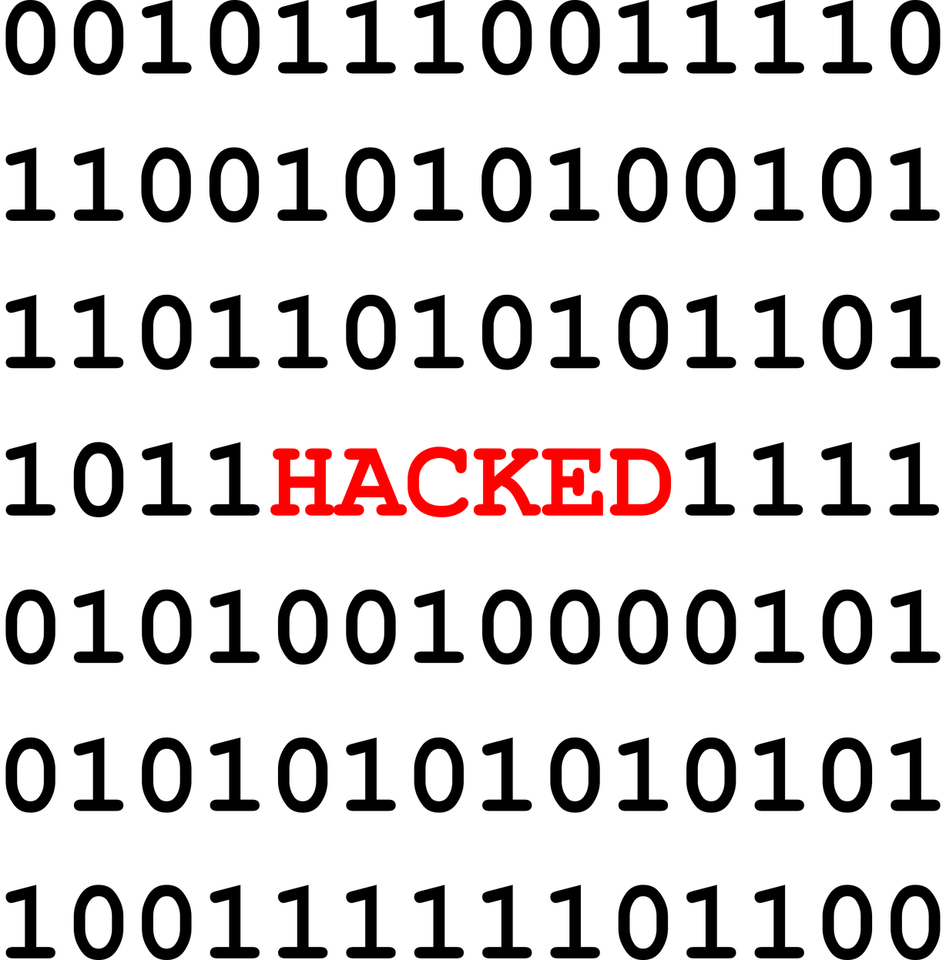
What is a cyber attack?
Malicious attempts to:
  Damage
  Disrupt
  Or gain unauthorised access
…to computer systems, IT networks or devices (such as laptops, phones and tablets)
Notes:
A cyber attack is where someone maliciously tries to:
Damage – for example by deleting a database (potentially also stealing a copy of it at the same time)
Disrupt – for example a Denial Of Service Attack, where someone uses a program to visit a website from lots of different devices at once in an effort to overload its capacity and cause it to crash. Sometimes this same result happens entirely innocently, such as during boxing day sales, you might have seen some retailers use a ‘queueing system’ to get access to their website in an attempt not to overload their own website.
Gain unauthorised access – for example by trying to guess your email password or getting you to hand it over to them by filling in a legitimate looking form. This will then give them access to your emails and any accounts where you are using the same email and password combination.
The second bullet point about the devices merely tries to show the different types of technology which could be ‘cyber attacked’

Slide 5

What is ‘cyber security’?
Reducing risk of becoming a victim of a cyber attack
Protection of devices, services, networks and the information we store on them
The internet is a fundamental part of modern life, and so cyber security must be too.
Notes:
Cyber security is the means by which individuals and organisations reduce the risk of becoming victims of cyber attack.
Cyber security's core function is to protect the devices we all use (smartphones, laptops, tablets and computers), and the services we access - both online and at work - from theft or damage. It's also about preventing unauthorised access to the vast amounts of personal information we store on these devices, and online.
Cyber security is important because smartphones, computers and the internet are now such a fundamental part of modern life, that it's difficult to imagine how we'd function without them. From online banking and shopping, to email and social media, it's more important than ever to stake steps that can prevent cyber criminals getting hold of our accounts, data, and devices.
***important to emphasise, that cyber security has other benefits for example helping protect information that could be destroyed through floods, fire or home/office robberies – we’ll talk more about this when we discuss backing up data***

Slide 6
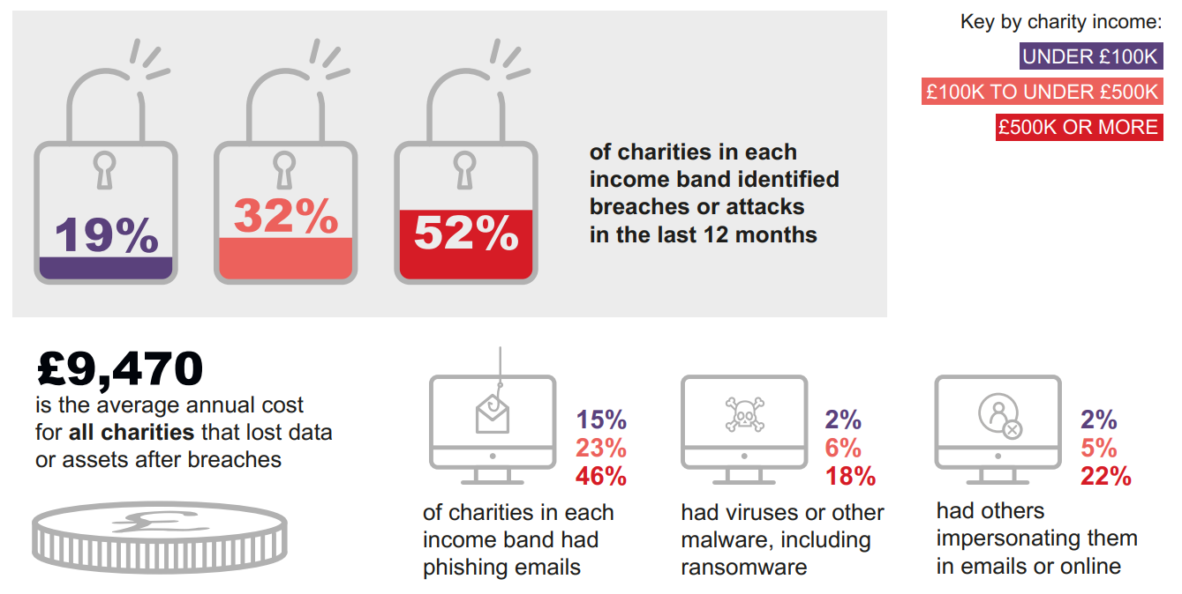
The cost of cyber attacks
Notes:
The infographic on the slide is a summary of the findings from Cyber Security Breaches Survey 2019, conducted for the Department for Digital, Culture, Media and Sport
The images of padlocks shows:
19% (in 2018 =13%) of charities with an income under £100,000 identified a cyber attack or breach in the last year. Its worth cautioning that in a lot of cases, smaller organisations are not aware that someone has or is trying to attack them. This figure is therefore likely to be higher in reality.
The figure more than increases significantly to 32% when you step up an income bracket to those charities with an annual income of £100,000 to £500,000, and as you can see reaches a staggering 52% for charities with an income over £500,000 per year.
The figures point to larger charities having a greater awareness of cyber security and therefore being more likely to spot an attack. There is little evidence to show that larger charities are being targeted more than smaller ones – in part because so many attacks are untargeted – something we’ll touch upon later.
The cost of dealing with an attack
The average annual cost of cyber breaches across all charities is now £9,470 (this has risen significantly since 2018, where for large charities it was £1,460).
The figures are likely to be higher for larger charities due to scale, but smaller charities are likely
What all of these figures show:
Responsibility for Cyber Security no longer rests with a handful of techy people, its something that all levels of an organisation must take seriously and begin to look at whether your charity is doing all it can to protect its self.
Source: https://assets.publishing.service.gov.uk/government/uploads/system/uploads/attachment_data/file/813599/Cyber_Security_Breaches_Survey_2019_-_Main_Report.pdf

Slide 7
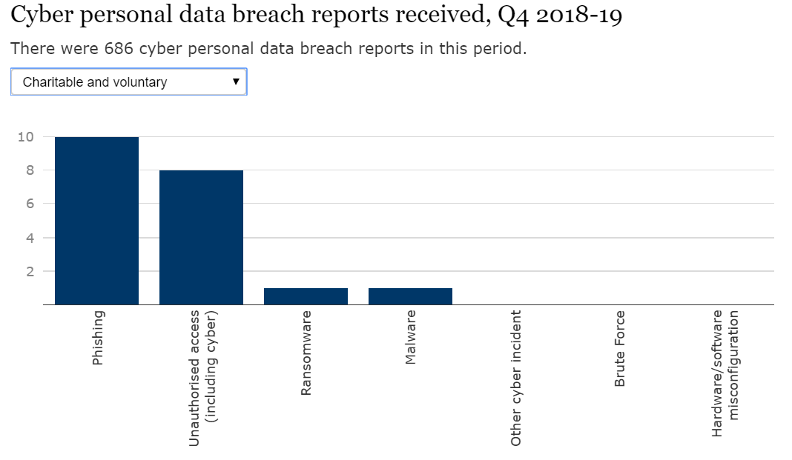
Data security incident trends - ICO

Slide 8

Why are charities at risk?
Charities hold funds, personal, financial and commercial data
Potentially a route into a ‘bigger fish’ such as a local authority or corporation
Very low levels of awareness, particularly amongst smaller charities
Culture of trust
Notes:
Charities hold funds, personal, financial and commercial data
Funds and data have a financial value to a cyber criminal, whether to use to try and attack another person or to sell on to other criminal entities.
In holding funds and data, often with low levels of security protecting it; charities become an easy target to cyber criminals and attackers.
While most small charities will not hold a lot of funds, cyber attackers approach most things with a cost vs benefit analysis. If they can get a quick win, and get say £1,000 from a poorly protected organisation its probably still worth their while. If you put in place the simple, sensible controls we talk about later then it will add a layer of protection that could be the difference between you being an attractive target or one that’s too time/cost consuming to be worthwhile to criminals.
Potentially a route into a ‘bigger fish’ such as a local authority or corporation
Many charities, through commissioned services, or grants from local authorities, are now fulfilling roles which were previously done by government, local authorities or larger companies. It is likely that to carry out these roles, the charity will need to share systems with the ‘bigger fish’ and a cyber attacker could use the charity as a route in; causing significant damage along the way.
It’s worth noting that a lot of commissioners are now putting in place minimum cyber security standards. This guidance is not a certification but will help you begin that journey. More information on the Government’s Cyber Essentials standard can be found at www.cyberessentials.ncsc.gov.uk/
Very low levels of awareness, particularly amongst smaller charities
The NCSC’s assessment conducted in late 2017 found that there were low levels of awareness, particularly amongst smaller charities who do not perceive themselves as a target; or even holding anything of value to an attacker. The NCSC judges that charities are falling victim to a wide range of cyber attacks.
Culture of trust
To be able to achieve their goals, charities have to be open, transparent and trusting of beneficiaries and the public. For example, its not uncommon for someone to call or email a charity and offer to give them money, no strings attached. This would never happen in a business, because everything is a commodity; which means that charities, by their very nature are potentially open to having their trust exploited by criminals.

Slide 9
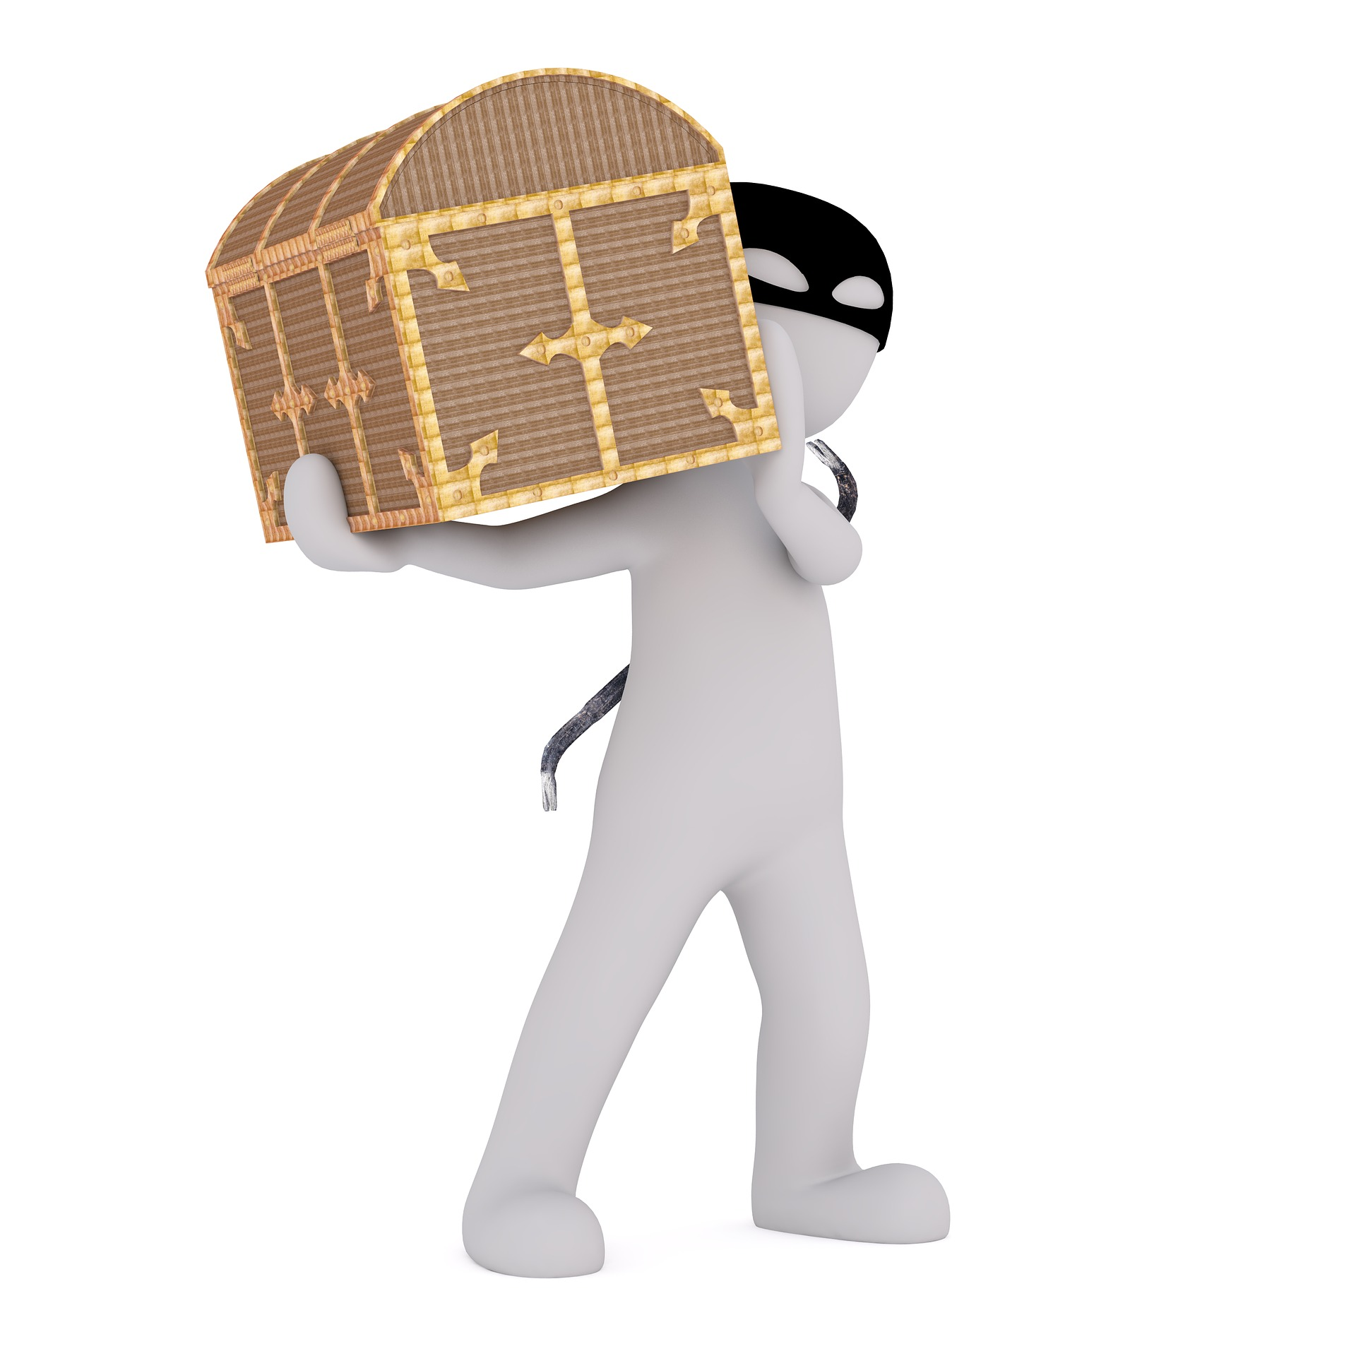
Who are charities at risk from?
Cyber criminals
  Motivated by money
Indirect attacks
Insiders
  And the inadvertent insider
Others but less likely for most charities
  Hacktivists
  Terrorists
  Nation states
Notes:
The myth of cyber criminals:
Thanks to Hollywood – we have a perception of a cyber criminal and it broadly follows this format:
A cyber attacker: He, always a he, is very young – late teens or early twenties. He hacked into his first nuclear missile facility at the age of just five. At the age of twelve he started on bank heists. He bought his first hoodie with the proceeds and his face has not been seen since. He works alternately for the Russian, Chinese, Iranian and North Korean Governments, and spends his free time in his bedroom in darkness with green letters and numbers for wallpaper. He is very clever with computers. In fact, he is so clever he cannot be defeated.
Thankfully, for the sake of the world this is a myth – certainly so far as the type of person your going to be protecting your charity from…
By way of a real life example of how easy cyber crime has become (not a charity specific one). Carl was working in a warehouse, earning not much more than minimum wage, when a friend showed him where he could buy lists of email addresses and associated passwords. These had been stolen from various data breaches and were now being sold on for other cyber criminals to use. Carl did not have a fancy IT degree, in fact by his own admission he had never been ‘taught IT’, but nevertheless he began buying these lists off the internet, and entering the email address and password combinations into loyalty card websites. Most weren’t successful, but when they were he would then convert the victims loyalty points into vouchers and then sell on the vouchers for slightly less than face value on legitimate auction websites. After a while he bought a piece of software that would automate a lot of the entering of email address and password combinations. In the year or so before Carl was arrested for fraud, he made in the region of £150,000 from this simple scam. Carl was not the technical wizard that Hollywood portrays, instead he simply exploited one of the most common things humans do…reuse the same password on lots of websites because its easy.
Cyber criminals
They are motivated by money, which means if it is going to cost them more in time and effort to steal your funds or data they are unlikely to bother. Consider the analogy with a traditional burglar; if you have a five lever mortice lock on your door, all the windows are locked, you have an obvious alarm and perhaps a dog; it is unlikely your average burglar is going to bother…its not worth the risk. If you take a similar approach to cyber security, a large proportion of cyber attackers wont bother with you.
Indirect attacks
Threats may not come from direct attacks on charities. It is common for charities, particularly smaller ones to outsource a large proportion of the IT and data to third parties. Cyber criminals and other groups may be able to gain access to a charity’s networks and/or information through these companies.
Charities, in a lot of sectors are stepping in to deliver commissioned services for local authorities and central government. In carrying out these contracts there is often a need to share systems and data with those larger organisations. It is possible, that in doing so they may be seen by cyber criminals as an easy route to get to the ‘bigger fish’. The NCSC is working on new guidance for suppliers to help make sure they are being diligent not to become a victim of a supply chain cyber attack.
Insiders
We have to trust staff, trustees and volunteers to use the charity’s IT systems and software safely and legitimately, however this trust has risks attached. Disgruntled users could pass on credentials to attacks, introduce malicious software to the system or steal data from the organisation.
More commonly though, an insider attack is not intentional. Many users may download a seemingly legitimate piece of software as part of their day to day work which contains a virus or malicious software or they may be using a weak password which is easily guessed by an attacker. Inadvertent insiders should not be blamed, but instead helping your staff to become more security conscious will help make sure they don’t become the weak link in the chain.
Others but less likely for most charities (up to the speaker whether to talk through these examples)
Hacktivists are hackers who are motivate by a specific cause for example to advance a political or personal agenda. In 2012 a hacktivist gained access to the website of a UK pregnancy advice organisation, defaced it and stole the personal information of 10,000 service users.
Terrorist organisations have been known to deface the websites of charity’s who are working against their aims as a terrorist group.
Nation State attacks on charities are very rare, however the Wannacry Attack in May 2017 which affected hundreds of thousands of businesses, charities and notably the NHS has been widely attributed to North Korea.

Slide 10
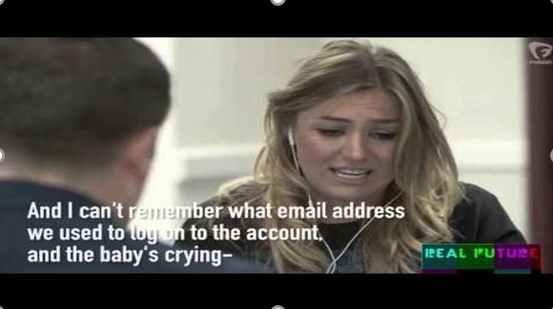
I’m pretty alert to scammers, I think I’m safe…
Notes:
YouTube link if the embedded video doesn’t work: https://youtu.be/lc7scxvKQOo
SAFETY WARNING – This video includes an expletive in it. Unfortunately no alternative is available that exemplifies the ease of the attack so well. It’s therefore up to individual CVS’ whether they choose to use the video.

Slide 11
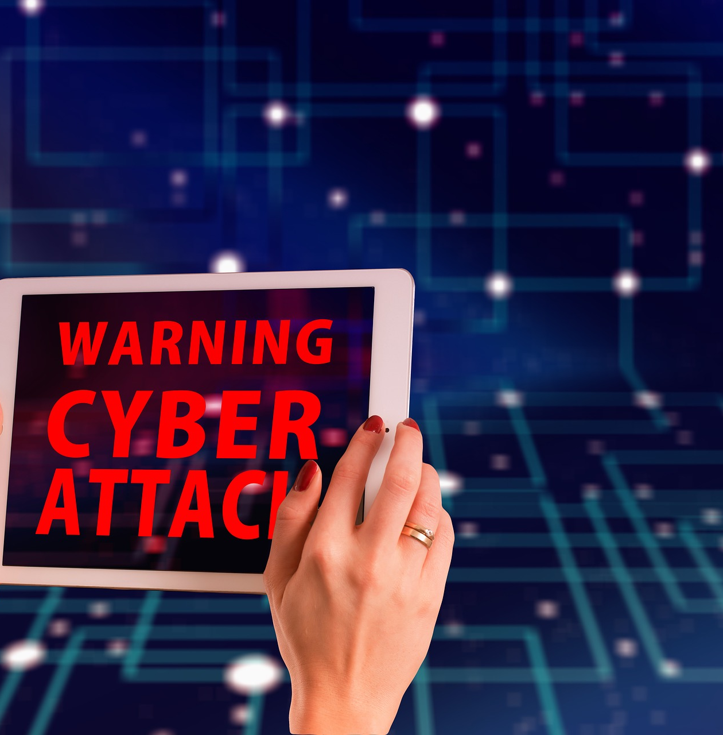
How are charities being attacked?
Ransomware and extortion
Malware and Spyware
Business email attacks (phishing)
Fake organisations and websites
Notes:
Ransomware and extortion
Ransomware is where a cyber attacker gains access to an organisations systems or website, locks it down so you cant access it and then offers to unlock it in exchange for payment of a ransom. Charities may be targeted directly, be inadvertently affected by an attack aimed elsewhere, or by mass indiscriminate campaigns seeking to exploit as many victims as possible. Attackers may not only steal or deny access to data; they may delete or change it.
Extortion is where a cyber attacker steals data or commercial information and threatens to release it publicly or sell it if you don’t pay them a fee. Charities involved in the protection of vulnerable individuals or holding sensitive medical data could be particularly susceptible to this form of extortion.
Malware and Spyware
Malware simply means malicious software. Attackers often try to get malware and spyware onto an organisations systems and devices to steal data or look for other more valuable leads for to use in future criminal acts. There are many ways to get malware onto your system or devices but common ones are by clicking on links on phishing emails or by visiting unsecure websites.
Business email attacks (phishing)
There are many ways that criminals can use email to launch cyber attacks. The most common ones are:
Tricking staff, trustees or volunteers into clicking on a link or attachment that seems genuine but in reality contains malicious software or sends you to a fake website.
tricking employees with financial authority into transferring money to criminals is increasing. A UK charity lost £13,000 after the email of its CEO was hacked and a fraudulent message sent to the charity’s financial manager with instructions to release the funds.
Gaining access to a staff member/volunteer work email address to send emails purporting to be from the organisation to build trust with a third party. This could be hugely damaging to your charity’s reputation if it led to losses by a third party or supplier of yours.
It’s worth noting the effect that this might have on staff’s mental health if they were tricked into handing money over to criminals in this way. More info is available in the ‘avoiding phishing’ section later on.
Fake organisations and websites
Criminals exploit the credibility and appeal of charities to trick donors into giving money to what appears to be a legitimate charity. This is often achieved through the creation of fake organisations and accompanying websites.
Criminals react quickly to exploit disasters and global events to steal donations. Although not directly targeting charities by cyber means, this activity has potential financial and reputational ramifications for genuine charities.

Slide 12

It’s time to attack your charity…
Notes:
Utilise the “attacking and defending your charity” facilitator notes

Slide 13
“Help the homeless” is a local homeless support charity. They have 8 trustees, 4 full time members of staff (CEO, Services Manager, Homeless Advisor, Office Assistant) and 1 part time finance manager who works Tuesday, Wednesday, Thursday.
All the staff have a work laptop and mobile phone. In addition they have 25 volunteers who assist with the charities activities supporting the homeless, they all have a charity email address which they access from their own devices through an online log-in form. The charity has an annual income of £200,000 and assets which include a night-shelter which also doubles as the charity’s office.

Slide 14
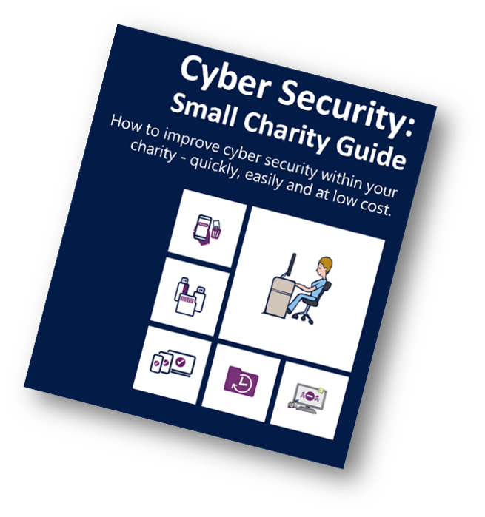
What can you do to protect your charity?
5 quick, simple, free or low cost steps
Notes:
In March 2018, The National Cyber Security Centre along with partners from across the sector launched Cyber Security: Small Charity Guide to help charities take simple steps to protect their charity. The next 5 slides take you through this guidance.

Slide 15

Backing up your data
Identify what you need to back up
Keep your back up separate
Consider the cloud
Make it part of your everyday routine
Notes:
Think about how much you rely on your charity’s critical data, supporter details, information on beneficiaries, volunteer data, governing documents, as well as invoices and payment details. Now imagine how long you would be able to operate without them.
All charities should take regular back ups of their important data. By doing this, you're ensuring your charity can still function following the impact of flood, fire, physical damage or theft and you’ll be more resilient to cyber crime.
Identify what you need to back up
Your first step is to identify your essential data. That is, the information that your charity couldn't function without, your “crown jewels”. Normally this will comprise documents, emails, contacts, legal information, calendars, financial records and supporter or beneficiary databases; most of which are kept in just a few common folders on your computer, phone, tablet or network. It’s probably best not to back-up the cat pictures and make sure you’ve not got lots of duplicate files as this will slow down your back ups.
Keep your back up separate
Whether it's on a USB stick, on a separate drive or a separate computer; your back-up is no good if its left connected to the device that is stolen, damaged or suffered a cyber attack.
Access to back-ups should also be restricted so that they are not accessible by all staff or volunteers as this will reduce the risk of someone accidentally damaging or deleting the back-up.
Consider the cloud
You've probably already used cloud storage during your everyday work and personal life without even knowing - unless you're running your own email server, your emails are already stored 'in the cloud’.
Using cloud storage means your data is in a physically separate location meaning it cant be damaged by a fire, theft or loss in your charity.
Cloud Service Providers can supply your charity with data storage and other services without you needing to invest in expensive hardware up front. They typically have higher levels of security than you could achieve for a similar investment to your subscription.
Most providers offer a limited amount of storage space for free, and larger storage capacity for minimal costs to charities.
If you operate in a rural area with poor internet speeds, backing up to the cloud might not be possible due to the speed needed to upload regularly. The required internet speed is usually available from suppliers, and you can then compare this to the speed provided by your broadband supplier.
Make it part of your everyday routine
Backing up is not an exciting task, and there are always things that are ‘more important’ but the majority of cloud storage now allows you to make back-ups automatically. Ensuring this is turned on will allow you to always have the most up to date version of your files if something goes wrong and also means you don’t have to think about it every day.

Slide 16

Protecting your charity from malware
Antivirus software
Prevent users from downloading
‘dodgy apps’
Keep everything up to date
Control the use of USB drives
Switch on your firewall
Notes:
Definition – Malware is the commonly used term for Malicious Software.
Antivirus software
Antivirus software is included for free with most popular operating systems. It’s usually just a case of making sure its turned on. Antivirus should be used on all computers and laptops. This is a hugely simple but effective way to detect and prevent malware from infecting your systems.
Smartphones and tablets differ in their need and availability of antivirus. The NCSC has produced guidance for the popular types of devices (visit ncsc.gov.uk) or consult your device supplier.
Prevent users from downloading ‘dodgy apps’
Users should only have enough ‘permissions’ on their account to carry out their role at the charity. By giving them permissions such as ‘administrator’ they have the ability to download a piece of dodgy software; probably by accident but it could have very damaging consequences.
Check what permissions your users have an unless they are in charge of the IT, make sure they don’t have an administrator account.
Some organisations may want to consider looking at our “bring your own device” guidance at www.ncsc.gov.uk/guidance/byod-executive-summary
Keep everything up to date
All of your devices will prompt you to ‘download and install’ the latest update. Carrying out these updates (a process often called patching) is one of the most important things you can do to improve security. Each update brings with it fixes for new vulnerabilities or defences against known attacks.
If you have the option to set your devices to update automatically then select that. It will mean you don’t need to worry about it again!
Control the use of USB drives
Its common practice to use USB drives or memory cards to transfer files between users and other organisations. However it only takes one person to put an USB stick or memory card infected with malware into one of your computers and it could cause significant damage to your systems.
To counter this you can:
Block access to USB ports on your computers – make a policy that all files should be transferred over email or cloud storage instead
Use an antivirus package that scans USB sticks when you plug them in before it lets you open them
Only allow approved USB sticks which are monitored and audited regularly. Some charities have a couple of numbered USB sticks which must be hung up in a secure cupboard at the end of each day and users are only allowed to use these.
Switch on your firewall
Firewalls simply create a buffer zone between your network and the internet. Most popular systems include a firewall for free, all you need to do is make sure its switched on. Easy enough?

Slide 17

Keeping your smartphones/tablets safe
Switch on password protection
Prepare for lost or stolen devices
Keep your device up to date
Keep your apps up to date
Use public Wi-Fi safely
Notes:
Smartphones and tablets leave your office and home on a regular basis, it’s the benefit of their portability; however, its also a weakness as they exposed to things that devices that are solely based in the office aren’t such as being lost or stolen and connecting to public Wi-Fi which can be insecure or being run by cyber criminals.
Switch on password protection
Virtually every device, whether it’s a phone or tablet (like an iPad) can be locked with a password or pin number.
These security settings are not always enabled when you first receive the device, simply go to your settings menu and set your pin/password. Make sure its not the same across all your devices and isn’t the same and the pin number for your debit/credit cards!
Prepare for lost or stolen devices
Trustees, staff and volunteers are more likely to have their devices stolen (or lose them) while out of the office or their home. Fortunately, the majority of devices include free web-based tools that are invaluable should you lose your device. These are very handy if there is sensitive data stored on the device which you don’t want to fall into the hands of others. Most devices allow you to;
track the location of a device
remotely lock access to the device (to prevent anyone else using it)
remotely erase the data stored on the device
retrieve a backup of data stored on the device
As all devices are different, its easiest to look at the support pages on the website of your device manufacturer (for example Apple, Samsung, Windows, Google etc)
Keep your device up to date
No matter what phones or tablets your charity is using, it is important that they are kept up to date at all times. All manufactures (for example Windows, Android, Apple) release regular updates that contain critical security fixes to keep the device protected. This process is quick, easy, and free and if your devices allows it you can save a lot of time by turning on automatic updates in the settings menu.
Its best practice to show your trustees, staff and volunteers how to check for updates and install them when you first give them a device, this opportunity also allows you to explain how important they are.
Keep your apps up to date
Just like the operating systems on your charity’s devices, all the applications that you have installed should also be updated regularly with patches from the software developers. These updates will not only add new features, but will also fix any security issues that have been discovered.
Similarly to keeping your device up to date, most apps now allow you to turn on auto-update in your settings which will make sure you don’t forget.
Use public Wi-Fi safely
We know that its incredibly convenient to connect to Wi-Fi in public spaces when your out and about, both personally and professionally. However, when you use public Wi-Fi hotspots (for example in hotels, coffee shops or public transport), there is no easy way to find out who controls the hotspot, or to be assured it’s secure. If you do connect to these, somebody could access: What your working on and your private login details for many apps and websites your using.
The simplest way to avoid the risk is not to connect to public Wi-Fi, instead use the 3G/4G connection on your smartphone or tablet. This means you can also use 'tethering' (where your other devices such as laptops share the 3G/4G connection from your phone), or a wireless 'dongle' provided by your mobile network.
If you’re regularly out of the office or handle sensitive data, it’s worth asking your IT provider about setting up a Virtual Private Network (VPN) which encrypts your data before its sent across the internet.

Slide 18
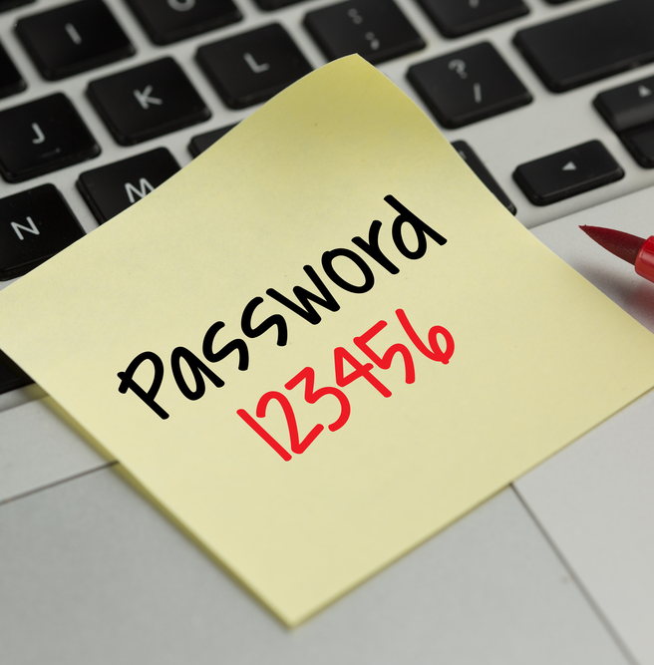
Using passwords
Switch on password protection
Use two factor authentication
Avoid predictable passwords
  3 random words
Help users cope with ‘password overload’
Change all default passwords
How long to crack these three passwords?
  QwErTy987123!
  CoffeeTinyFish
  CoffeeTinyFish#9
Notes:
Switch on password protection
As with your mobile devices, one of the best and easiest ways you can protect your devices and accounts is by using passwords (or pin numbers on some devices). You can also use other authentication methods such as fingerprint or ‘face unlock’, this means you wont be needing to enter your password as often.
Use two factor authentication
Two factor authentication requires two different methods to 'prove' your identity before you can use a service, generally a password plus one other method. This could be a code that's sent to your smartphone (or a code that's generated from a bank's card reader) that you must enter in addition to your password.
Using this service means that an attacker needs to have something you know (your password) and something you have (card reader/phone to receive text message) which makes it much more secure.
For detailed guidance on how to turn on two factor authentication on most well-known services visit www.turnon2fa.com
Avoid predictable passwords
Using strong passwords is an important way to protect your charity’s valuable data. Make sure trustees, staff and volunteers are given actionable advice on setting secure passwords that is easy for them to understand.
A good rule is to use three random words to create a strong password. Avoid using the most common passwords, which criminals can easily guess (such as P4$$w0rd or QWERTY).
Your charity’s IT systems should not require trustees, volunteers or staff to share accounts or passwords in order to get their job done. Make sure that every user has personal access to the right systems. As we mentioned earlier you should only give ‘administrator’ access to those who need it or manage the systems like the IT person.
Help users cope with ‘password overload’
Where you do use passwords to access a service, do not enforce regular password changes. Passwords really only need to be changed when you suspect a compromise of the login credentials.
The NCSC is also advocating writing your important passwords down; we know this goes against everything you’ve been told, but it is likely to be much safer to write it down and lock it somewhere safe (not with your device) than risk using a password that’s easy to crack.
You may also have heard of ‘password managers’, which are tools that can create and store passwords for you that you access via a 'master' password. Since the master password is protecting all of your other passwords, make sure it’s a strong one, for example by using three random words. Have a look at the star ratings in your devices App Store to make sure you’re choosing a reputable one. The NCSC has further advice on password managers on their website – www.ncsc.gov.uk (for browser based password managers – Ensure you keep your web browser up-to-date and you have some kind of access control on your device such as a PIN/password/biometric.
Change all default passwords
One of the most common mistakes is not changing the manufacturers' default passwords that smartphones, laptops, and other types of equipment are issued with. Often credentials they are issued with are as simple as Username: Admin; Password: Password – which means if you know what they are then so does a cyber attacker.
We used a password strength check to test it which uses common password dictionaries, regular dictionaries, first name and last name dictionaries and others. It also performs substitution attacks on these common words and names, replacing letters with numbers and symbols – for example it’ll replace A’s with 4’s and @’s, E’s with 3’s, I’s with 1’s and !’s and many more. Substitution is very typical by people who think they’re making passwords stronger – hackers know this though so it’s one of the first things hacking software uses to crack a password
QwErTy987123! Cracked in 15 seconds
CoffeeTinyFish = 6 hours
CoffeeTinyFish#9 = 6 years
Check your password strength at: www.howsecureismypassword.net/
You can check whether your email address and/or password have been exposed in a data breach by another company by visiting www.haveibeenpwned.com

Slide 19
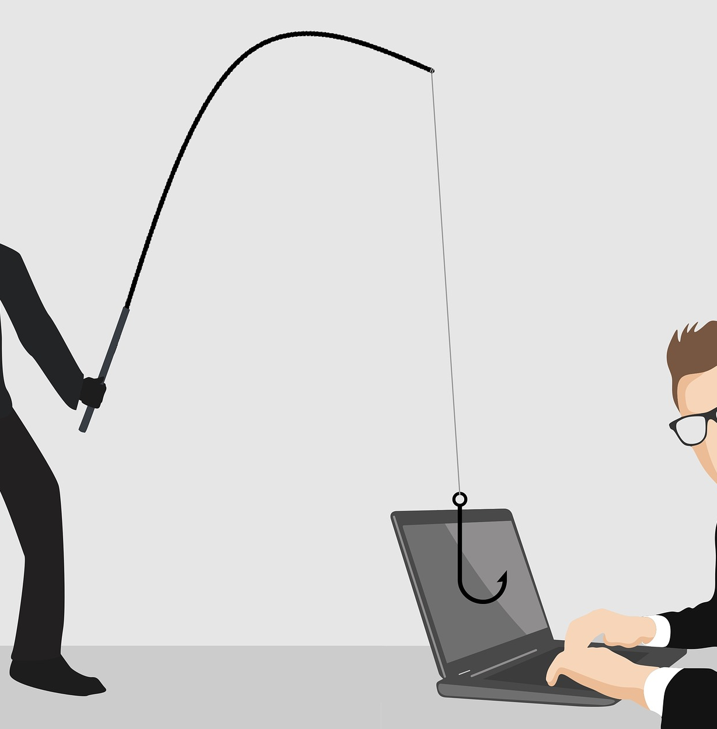
Avoiding phishing attacks
Configure accounts appropriately
Think about how you operate
Know the obvious signs of phishing
Check your digital footprint
Report all attacks
Notes:
In a typical phishing attack, scammers send fake emails to thousands of people, asking for sensitive information (such as bank details), or containing links to bad websites. They might try to trick you into sending money or steal your details to sell on to a 3rd party.
Configure accounts appropriately
Its important to make sure that your charity’s IT is set up to protect your charity if you suffer a phishing attack. Simple steps you can take are;
Give everyone their own account
Make sure users have the ‘least privileges’ needed to carry out their role – for example only able to access data that they need to see.
Only give full system access (Adminstrator access) to those who need it – for example the person that manages your IT.
Use two factor authentication (2FA) on your important accounts such as email. This means that even if an attacker knows your passwords, they still won’t be able to access that account.
These steps will help minimise the damage that is caused by preventing an attacker gaining access to as much of your system as possible.
Think about how you operate
Consider ways that someone might target your charity, and make sure your trustees, staff and volunteers all understand normal ways of working. For example, do your users know who your organisation works with – would they open an email from just anyone? Common tricks include sending an invoice for a service that you haven't used, so when the attachment is opened, malware is automatically installed (without your knowledge) on your computer
Another common scam is to trick staff into transferring money or information by sending emails that look authentic. Work with your trustees, staff and volunteers to see how you can help make these tricks less successful. For example;
Do users know what to do with unusual requests, and where to get help?
Would users be willing to challenge an important individual (a trustee perhaps) if the request was unusual or asked them to circumvent the normal process?
Do you understand the day-to-day relationships your charity has? Scammers will often send phishing emails from large organisations (such as banks) in the hope that some of the email recipients will have a connection to that company. If you get an email from an organisation you don't do business with, treat it with suspicion.
Encourage staff to have the confidence to ask ‘is this genuine?’ can be the difference between staying safe, or a costly mishap.
Know the obvious signs of phishing
Expecting your trustees, staff and volunteers to identify and delete all phishing emails is an impossible request and would have a detrimental effect on a charity’s productivity. However there are some obvious signs which you can help your users be on the look out for;
Poor spelling, grammar and punctuation
Is the design (and quality) what you'd expect from a credible, large organisation?
Is it addressed to you by name, or does it refer to 'valued customer', or 'friend', or 'colleague’?
Does the email contain a veiled threat that asks you to act urgently? Be suspicious of words like 'send these details within 24 hours' or 'you have been a victim of crime, click here immediately’.
Look out for emails that appear to come from a high-ranking person within your organisation, such as a trustee or manager asking you to do something they wouldn’t normally ask.
If it sounds too good to be true, such as a large donation in return for banking details, it might well be. Try picking up the phone (using a number you already know to be correct) and check with the sender that its genuine.
Check your digital footprint
Attackers use publicly available information about your charity and staff to make their phishing messages more convincing. This is often gleaned from your website and social media accounts (information known as a 'digital footprint’).
Check whether the information you have on your website is completely necessary for your normal visitors - could attackers utilise information about managers or trustees to trick an unsuspecting staff member or volunteer?
Help your staff understand how sharing their personal information can affect them and your charity. People shouldn’t remove all trace of themselves from the internet but understanding the consequences of publicising information about themselves and your charity will help stop your charity becoming a target.
Report all attacks
Make sure that your trustees, staff and volunteers are encouraged to ask for help if they think that they might have been a victim of phishing. It’s important to get the person who manages your IT to scan for malware and change passwords as soon as possible if you suspect a successful attack has occurred.
Do not punish staff if they get caught out. It discourages people from reporting in future, and can make them so fearful that they spend excessive time and energy scrutinising every email they receive. Both these things cause more harm to your charity in the long run.
We’ll talk about where to report to Police and others on the next slide.

Slide 20

https://youtu.be/TFlCLREWxfU

Slide 21

How much about me can people see online?
Notes:
Link in case embedded video doesn’t work: https://youtu.be/_YRs28yBYuI
Understanding your digital footprint
It's worth exercising some caution when using social media. Not everyone using social media is necessarily who they say they are. Take a moment to check if you know the person, and if the friend/link/follow is genuine.
Less obviously, you should think about your digital footprint, which is a term used to describe the entirety of information that you post online, including photos and status updates. Criminals can use this publicly available information to steal your identity, or use it to make phishing messages more convincing. You should:
Think about what you're posting, and who has access to it. Have you configured the privacy options so that it's only accessible to the people you want to see it?
Consider what your followers and friends need to know, and what detail is unnecessary (but could be useful for criminals).
Have an idea about what your friends, colleagues or other contacts say about you online.
Above bullets are taken from https://www.ncsc.gov.uk/guidance/social-media-how-to-use-it-safely (follow the link to find out more)

Slide 22
It’s time to defend your charity…
Notes:
Utilise the “attacking and defending your charity” facilitator notes

Slide 23
Home working
Someone has had an operation and needs to work from home for one month.
Risks?
Mitigations?

Slide 24
Outreach service delivery
You take a laptop to a number of community venues around the borough to provide outreach advice sessions.
Risks?
Mitigations?

Slide 25
Referring clients
You make and receive client referrals from local statutory and voluntary sector organisations.
Risks?
Mitigations?

Slide 26
Staff turnover
A member of staff who’s been with you for 10 years leaves your organisation.
Risks?
Mitigations?

Slide 27

What to do if you fall victim
Action Fraud
  Police Scotland if appropriate
ICO Breach Notification
  Always within 72 hours
Charity Commission
  Reporting a Serious Incident (RSI)
Other Regulators/Funders
  If applicable
Notes:
There are up to 3 organisations you should report to if you fall victim to a cyber attack.
Action Fraud is the Police’s central fraud reporting centre in the UK. You can either report through their website www.actionfraud.co.uk or if you think the attack is still in progress call them on 0300 123 2040 which is open 24/7 with trained advisers.
Reporting to Police may be a requirement of your insurance policy. It will also help identify trends affecting charities and businesses which the Police may be able to take action against.
The Information Commissioners Office (ICO) is the data regulator in the UK.
Under the new Data Protection Act 2018 (also known as GDPR) there is a requirement for organisations to report a personal data breach that affects people’s rights and freedoms, without undue delay and, where feasible, not later than 72 hours after having become aware of it.
Quote from the ICO website - ”The ICO will not expect to receive comprehensive reports at the outset of the discovery or detection of an incident – but we will want to know the potential scope and the cause of the breach, mitigation actions you plan to take, and how you plan to address the problem.”
The Charity Commission (details taken directly from their website)
The Commission requires charities to report serious incidents. A serious incident is an adverse event, whether actual or alleged, which results in or risks significant:
loss of your charity’s money or assets
damage to your charity’s property
harm to your charity’s work, beneficiaries or reputation
The most common type of incidents are frauds, thefts, significant financial losses, criminal breaches, terrorism or extremism allegations, and safeguarding issues.
If a serious incident takes place, you need to report what happened and explain how you are dealing with it, even if you have reported it to the police, donors or another regulator.
To report a serious incident you should email RSI@charitycommission.gsi.gov.uk
Other Regulators
Some charities may also be subject to other regulators depending on their field who it may be a requirement to report a cyber security incident to.
Some trust and grant funders require you to inform them if you have suffered an adverse incident. Check the terms of any funding you have in case you need to report to them also.

Slide 28

The UK’s only software donation programme. It’s completely free to register and gives charities access to software savings of up to 96% on products such as Microsoft Office, Norton Antivirus, Adobe Acrobat XI and much more.
www.charitydigitalexchange.org/
Notes:
NCSC and Charity Digital (formerly Tech Trust), the owners of Exchange have been working together to ensure that charities are able to access heavily discounted software licenses and products that allow them to follow the guidance in the Cyber Security Small Charity Guide.
Exchange is the only software donation programme in the UK, and is open to any charity registered with the Charity Commission or ones who hold HMRC charitable status (X number).
Charities must first register at www.charitydigitalexchange.org/ and will then be given access to the full catalogue of products.
Please note NCSC has not assured these products for quality, however Exchange is an established provider and will be able to provide advice and guidance on suitable products should charities require it.
The 4% charge (of the original cost of the software license) is an admin fee levied by Charity Digital to ensure the programme is sustainable.

Slide 29
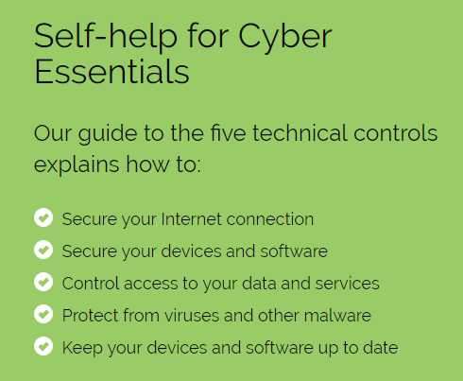
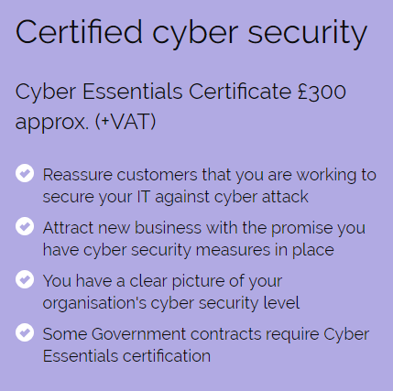
Cyber Essentials
Govt backed scheme - https://www.cyberessentials.ncsc.gov.uk

Slide 30
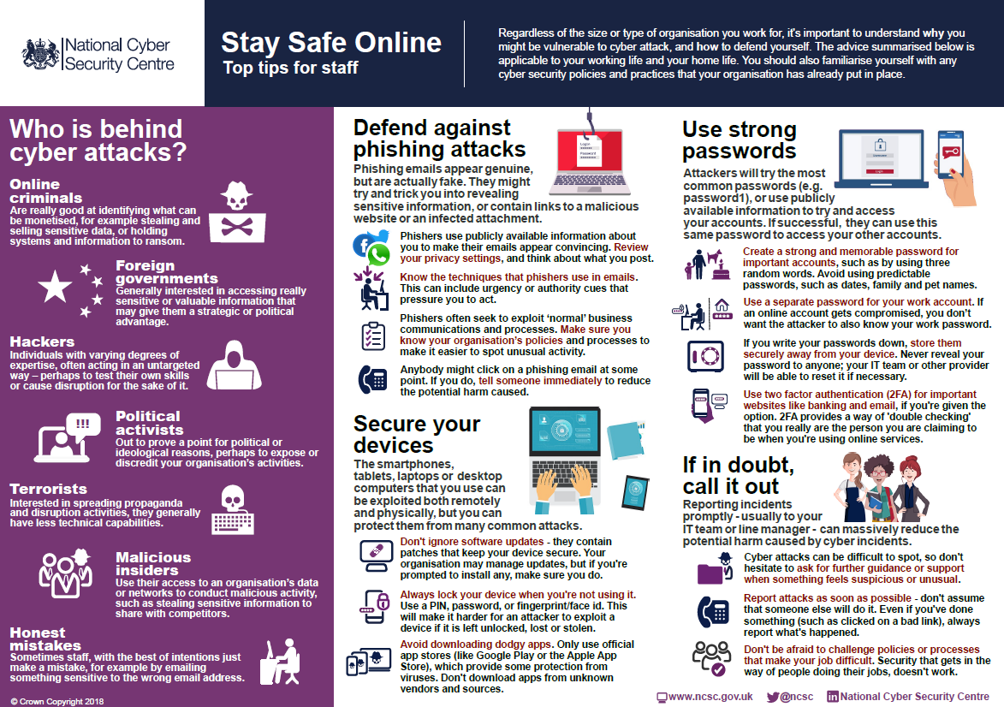

Slide 31
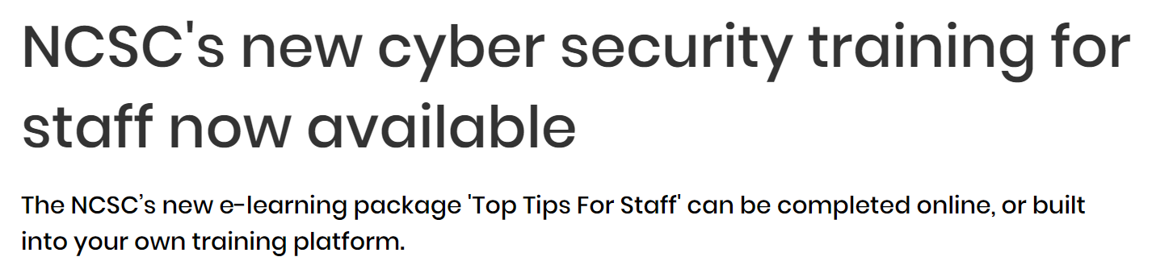
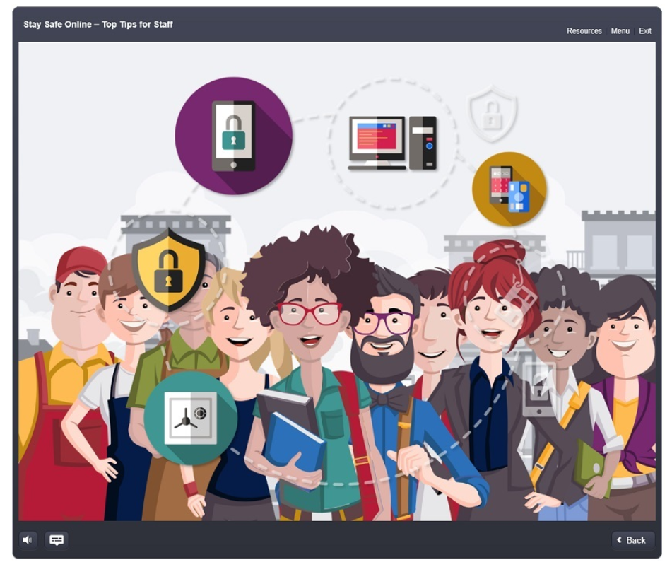

www.ncsc.gov.uk/training/top-tips-for-staff-web/story_html5.html

Slide 32

Thank you!
Any questions?
More information
  www.ncsc.gov.uk/charity
Get in touch
  info@kva.org.uk
  info@superhighways.org.uk

