Slide 1


Interviewing and Recording
Notes:
Name, organisation and if you could interview anyone alive or dead, who would it be?

Slide 2

Who would you interview and why?
And can be someone that from the past, or no longer living…
Notes:
Re-cap on who we are

Slide 3
Learn about techniques and digital tools you need to interview the people your charity or community group works with about their experiences

Slide 4

What we’ll cover today
Simple interviewing techniques
Consider recording best practice
Select free and affordable tools for audio capture – online hosting, devices, apps and accessories
How to turn your recording into a written transcript

Slide 5
Quick poll…have you ever??
Notes:
Question 1: Single answer
Interviewed someone
Been interviewed
Both
Neither
Question 2 – multiple choice
Made notes during an interview
Recorded an audio interview
Transcribed a recording
Edited a recording for publication
All of the above
None of the above
Something else

Slide 6


Why interview? When not to?
In small groups: write one post it for each idea
Go the Jamboard
Notes:
Possibly split into two groups – one tackles each?

Slide 7
Planning your interviews
What questions might we ask ourselves?
And what do we need to do?
Answers in chat please…
Notes:
Cover ethics here too: Editorial planning – content:
Why are you recording this interview?
Why have you chosen this person?
What do you want out of it?
What are you using it for?
Who will be listening??
What about location? Is it remote or online
Do you need ambient sound for example to make the story come alive?
How much of it are you going to use (are you after a soundbite or an in depth story)
Worst case scenario is a long interview which you then have to wade through and edit, and which doesn’t quite hit the mark in terms of its content.
Do no harm
Honesty and fairness
Data protection
Reciprocity
Confidentiality and anonymity
Informed consent
Inclusion
Competence, independence and integrity of those responsible

Slide 8
Planning the interview
Why? (what are you trying to find out?)
Who? (who is your population and who are your interviewers?)
How? (Online, phone, face-to-face)
Where? (if face-to-face)
What? (what are you going to ask?)
Be aware of barriers!

Slide 9

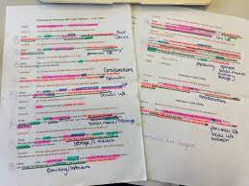
Insights or storytelling?
Looking for themes, making changes & sharing findings
Sharing a story to raise awareness or motivate action

Slide 10
Semi-structured interviewing for exploration and insights
… is a scheduled activity
Uses an interview guide
Interviewer is prepared and in control, but not controlling
Max. 1 hour
Notes:
When you evaluate a project/programme
If you are exploring a new area of work
If you are interested in the thoughts, interpretations and meanings about a subject – ‘rich data’
Lived and learned experience
Labour intensive
Interviews
Transcription
Data analysis
Sample sizes are usually small
Don’t expect facts

Slide 11

Brain pause

Slide 12

QUESTIONS
SIMPLE
TECHNIQUES

Slide 13
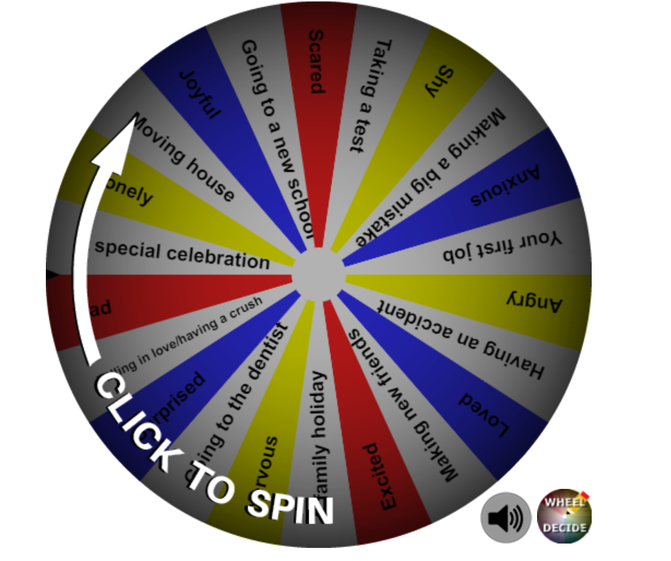
Looking for stories
You will take turns being an interviewer and an interviewee.
As an interviewer you must spin the wheel to find the subject of your interview.
Don’t tell the interviewee what it is!
Try and find a story from their life that if asked you could summarise for others

Slide 14

Reflections…
How can you ask questions or follow up questions?

Slide 15

WELLBEING AT WORK
DURING COVID-19
What needs do people have as they return to face to face settings at work
Notes:
https://docs.google.com/document/d/1siEKH2EIc6i4faBqsU3mrkbN9NwjosKkCUL1w1akgc0/edit?usp=sharing

Slide 16
In your breakout groups
(15 mins)
Think about how you would start an interview about this subject
Develop 4-5 questions about a particular aspect of the subject you would like to explore
We’ll return to the main space to reflect on questions.
Then we’ll take it in turns to interview.
Notes:
Could we ask them as a group to put together a series of questions for you to ask me?
And we could record it & transcribe it?
Might be time consuming? But would show it in practice?
Or give them a topic after showing them the developing questions slide and get them into two groups to come up with a series of questions?
15 minutes

Slide 17
Follow up question techniques for insights
Ask for an example
Ask for meaning (“What does that mean?”, “What does/did that mean to you?”)
Provide some evidence (”What makes you say that?”)
Ask for more detail (“Can you tell me more?”)
Reflect back to check understanding
Verbal and non-verbal agreement (express interest)
Notes:
Could we ask them as a group to put together a series of questions for you to ask me?
And we could record it & transcribe it?
Might be time consuming? But would show it in practice?
Or give them a topic after showing them the developing questions slide and get them into two groups to come up with a series of questions?
15 minutes

Slide 18
Avoid
Leading questions
Double questions
Loaded questions
Ambiguous questions
Jargon
Assumed knowledge
Overly sensitive questions
Notes:
Ask group if they can come up with an example of each
e.g. What did you like about our amazing newsletter?
How did you get involved with our drop in advice session and how does it compare to other drop in activities?
How much time do you waste on social media?
Where do you like to work?
What do you weigh?

Slide 19
Developing questions for exploration and insights
Start with your overall research/evaluation question
  E.g. why do some young people join gangs?
Develop a number of areas or topics to be explored
  Tell me about your life (life story, family, friends, school etc)
  How did you join a gang? Or What made you want to join?
  What is the best part of being in a gang?
  What is the hardest part of being in a gang?
  What does it mean to be part of a gang?
  Describe your daily routine of being part of a gang.
  Tell me about your jobs and roles within the gang. What do you get out of it?
  What are your dreams and goals? Do you think being a gang member will help you fulfil your dreams and goals?

Slide 20
Questions for storytelling
Plan questions to elicit strongest response
Ask the same question – get the right answer (forewarn them!)
Easy starter – warm up?
End for surprise/reflection
Notes:
Could we ask them as a group to put together a series of questions for you to ask me?
And we could record it & transcribe it?
Might be time consuming? But would show it in practice?
Or give them a topic after showing them the developing questions slide and get them into two groups to come up with a series of questions?
15 minutes

Slide 21
HOW TO
RECORD AND TRANSCRIBE YOUR INTERVIEWS

Slide 22
Quick question…
What do we need to consider before we record the interview?

Slide 23
Pre-recording
…do you have consent?
You have told people you are recording
It’s stored safely
Are you publishing people’s stories?
Virtual consent – forms, audio (video?)
Notes:
Add re virtual consent?

Slide 24
Recording considerations
With the following ways of recording your interviews, what do you need to consider?
Go the Jamboard

Slide 25


What equipment will you need?
Or already have?
Notes:
Phone – mobile, landline
Speaker phone / Dictaphone
Headphone recorder
Recording apps – be careful re consent!!
Some of these of course have to be used in tandem.

Slide 26
Quick poll: what’s your worst…??
Notes:
What’s your worst recording fear?
I didn't hit the record button
The sound was too low - I can't hear anything!
I don’t know where the file saved
My equipment isn’t working
There's a loud banging sound in the background
None of these - I've got my own nightmares thanks

Slide 27
Top tips for recording
Know your equipment
Use a microphone
Have a work flow
Control your environment where possible
Easy test runs
Be kind to yourself

Slide 28
Transcribing
Phone speech notes (might be hard virtually)
AI transcription
Other free converters
DIY listening and typing
What do you already have in your tool box? E.g. Captions on your videos

Slide 29

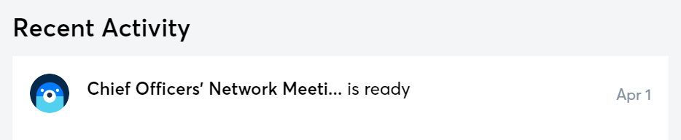
Recording &
Transcribing – Otter.ai DEMO
https://otter.ai/pricing
There are others (but paid for multi-language e.g. Rev and Sonix

Slide 30
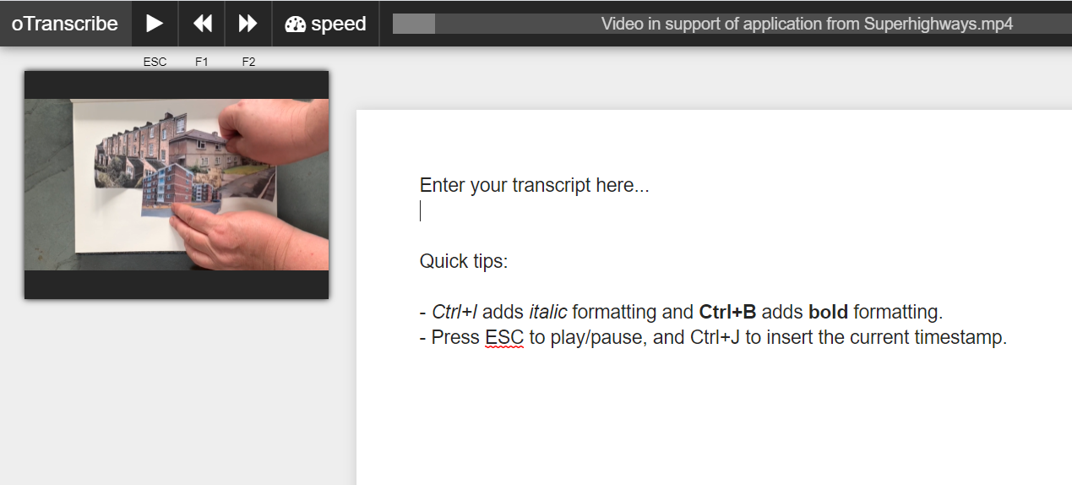
DIY transcribe – O-transcribe
DEMO

Slide 31

Try it for yourself:
Download this audio file (a quote from Superhighways digital skills research in 2020)
Go to O-transcribe
Upload the recording
Transcribe the recording
If you have time and want to, create your Otter.ai free account
Alternatively insert this YouTube video about You Can Make Music

Slide 32
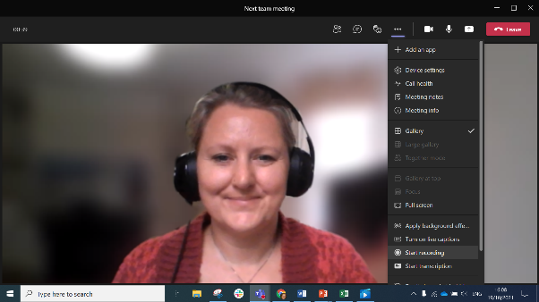
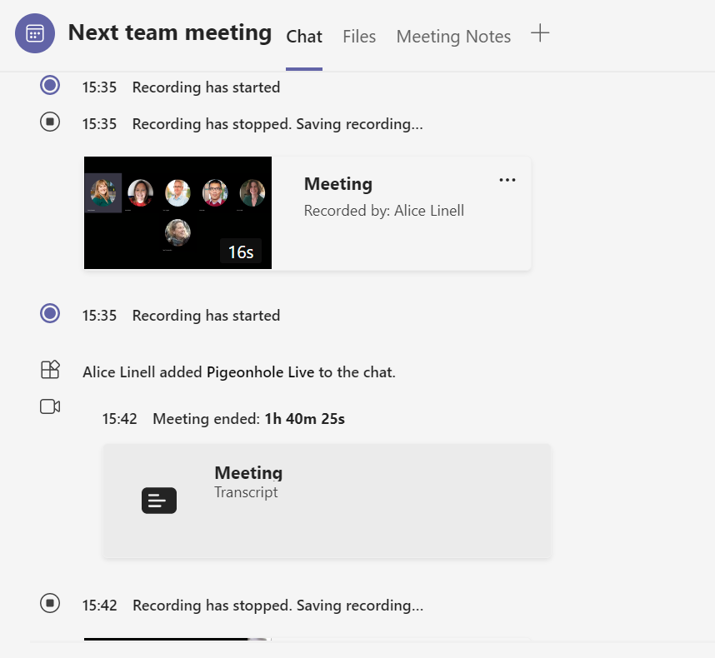
Auto-transcribe with Microsoft Teams
Record your meeting
You can access your recording and transcript in the calendar invite
And saves to either One Drive or SharePoint

Slide 33
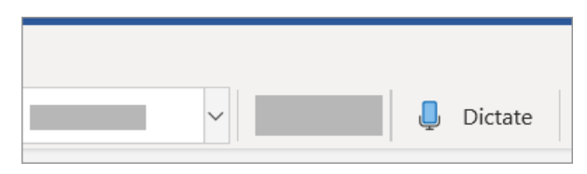
Auto transcribe – Office 365 dictate demo

Slide 34
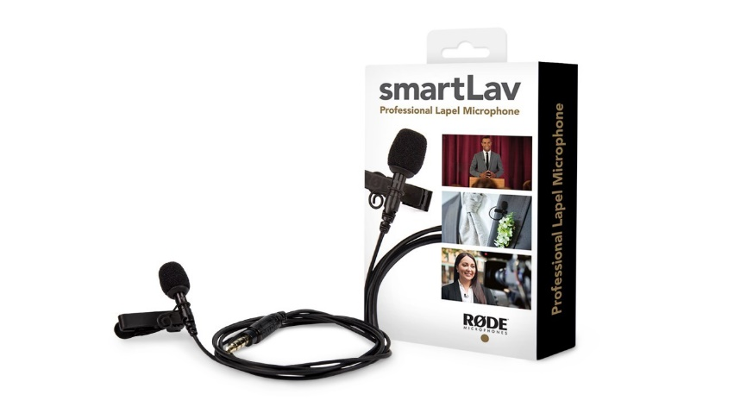

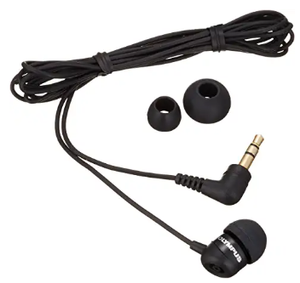
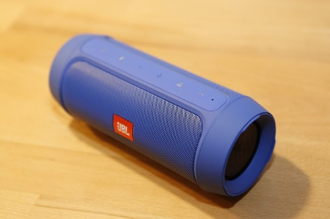
Some other helpful tools and techniques…
Lapel mic – plug into your phone (face-to-face)
Telephone pick up mic – insert into your ear and your recording device
Use a mobile app e.g. Automatic Call Recorder
(don’t forget to switch it off)
Play it loud for dictate, Otter or speech notes to more easily pick up the sound

Slide 35
TOOLS TO
EDIT AND PUBLISH YOUR RECORDINGS

Slide 36
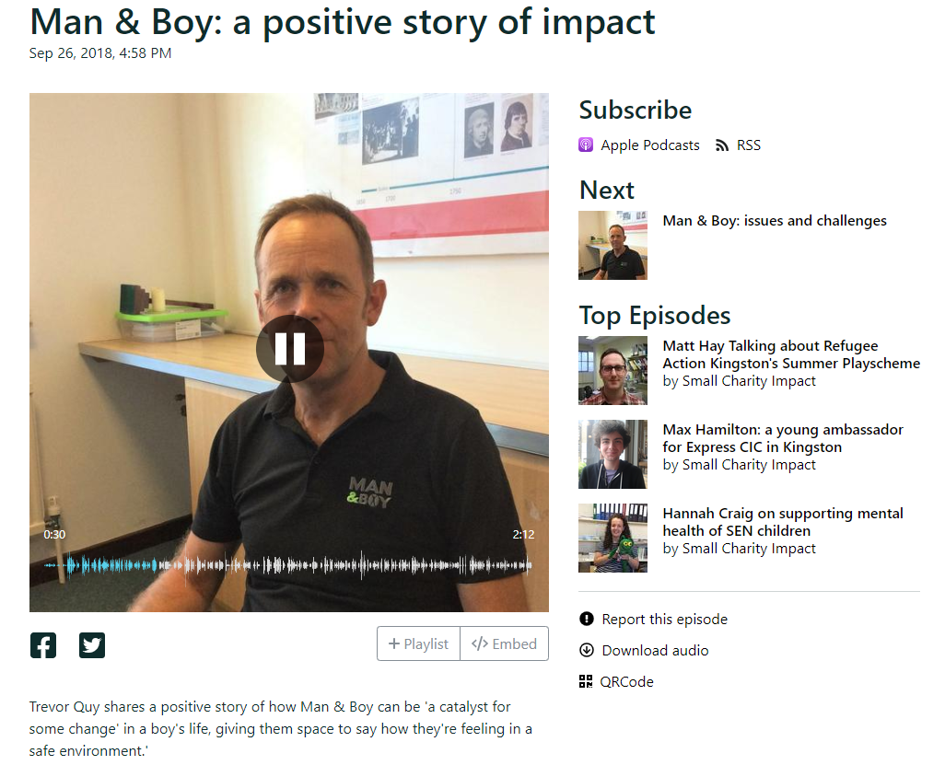



Publishing
Notes:
Possibly Anchor app too – any other audio sharing sites??

Slide 37
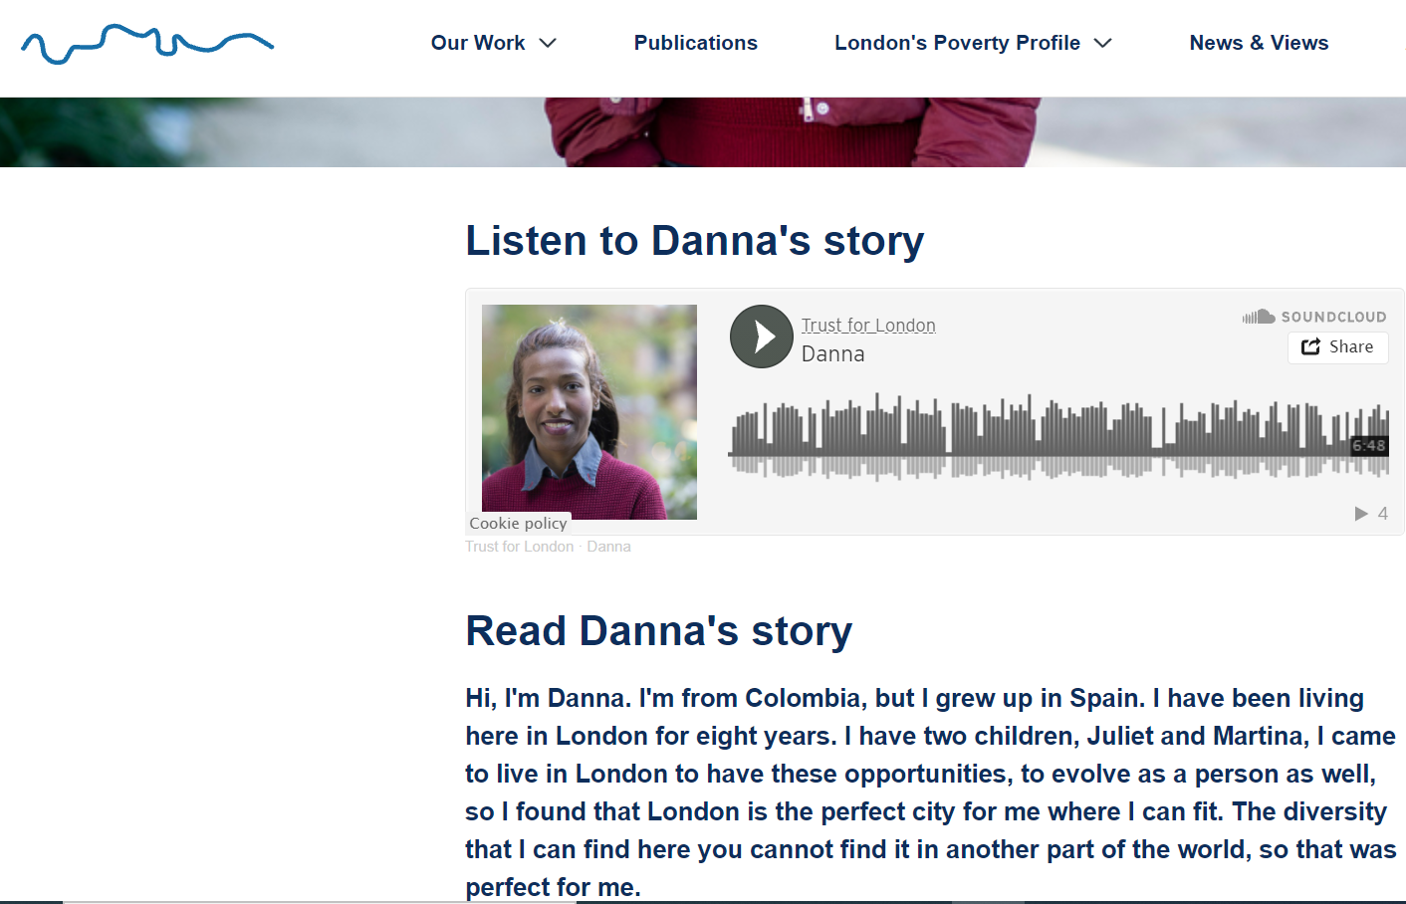
https://www.trustforlondon.org.uk/issues/london-looks-like/danna/

Slide 38
Editing
Simple audio edits are available in publishing sites
Audio edit apps on phones
Audacity – free open source for desktop (our fave).
See our step-by-step guide to editing with Audacity

Slide 39
Storing your data?
Download the right apps to your device
Which account are you signed in with?
Delete recordings where necessary
Make time…
…and form good habits
Notes:
Office 365 / Google Drive apps. Are you signed in with your personal accounts on personal devices? Know how to switch between accounts?
Do you know how to access files on your device? Know your device.
Do you have a work laptop or personal? Do you know how to set up a work profile if you are using a personal computer or laptop?

Slide 40
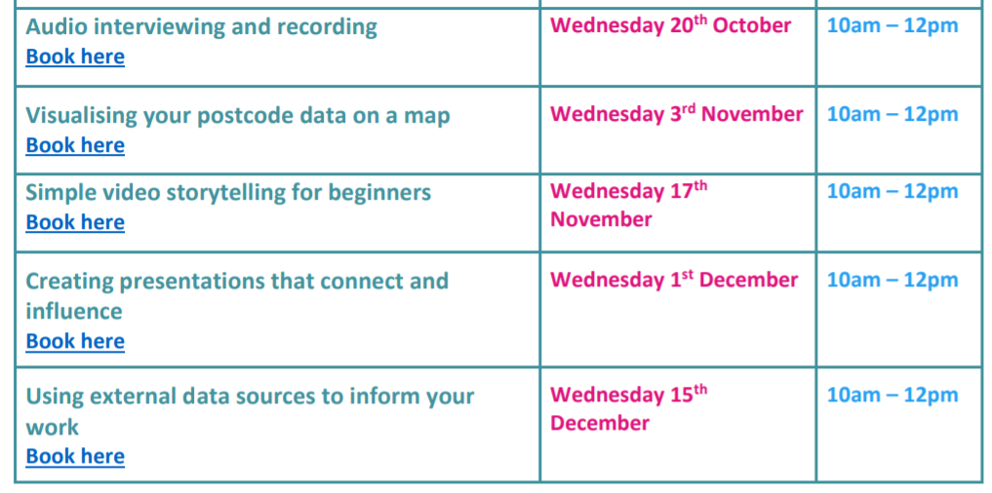
Next steps
Ask us for help if you need it
Further training available – book now!
Sign up for e-news

Slide 41

Final thought
Notes:
Office 365 / Google Drive apps. Are you signed in with your personal accounts on personal devices? Know how to switch between accounts?
Do you know how to access files on your device? Know your device.
Do you have a work laptop or personal? Do you know how to set up a work profile if you are using a personal computer or laptop?

Slide 42



Thank you for listening
Sorrel parsons
sorrelparsons@superhighways.org.uk
www.datawise.london
www.superhighways.org.uk

Slide 43

What’s next?
Analysing your interviews
Other training
How to get support with your data

Slide 44






Our mission is to help you unlock the value of your data.

Slide 45
Becoming more datawise
Complete our session evaluation
Register for Datawise London support
Check training opportunities on our Eventbrite page
Sign up to our eNews

Slide 46

COMFORT BREAK

