Slide 1


Hands on: Datawrapper charts

Slide 2
Why Datawrapper
Easy to use online tool
Paste data or upload files
Lots of customisation options
Embed interactive charts online
Download as a PNG file
Visualisations & data private until you Publish
Link to a live dataset for real time updates
Good accessibility options inc alt text prompts & colourblind check
Free version supports all of the above
Great help & support, with an inbuilt learning academy including best practice in data visualisation

Slide 3
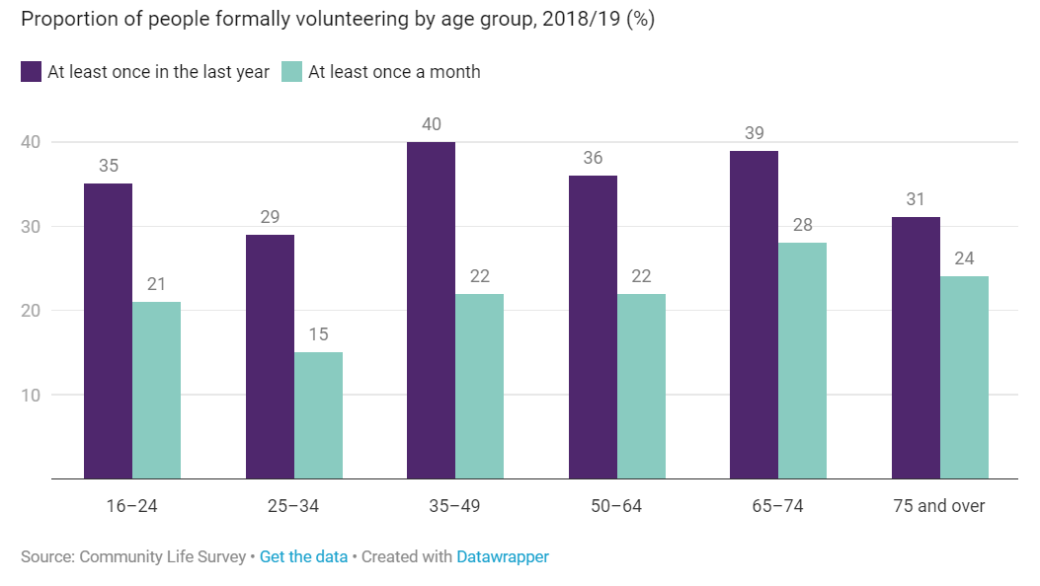
NCVO Almanac

Slide 4
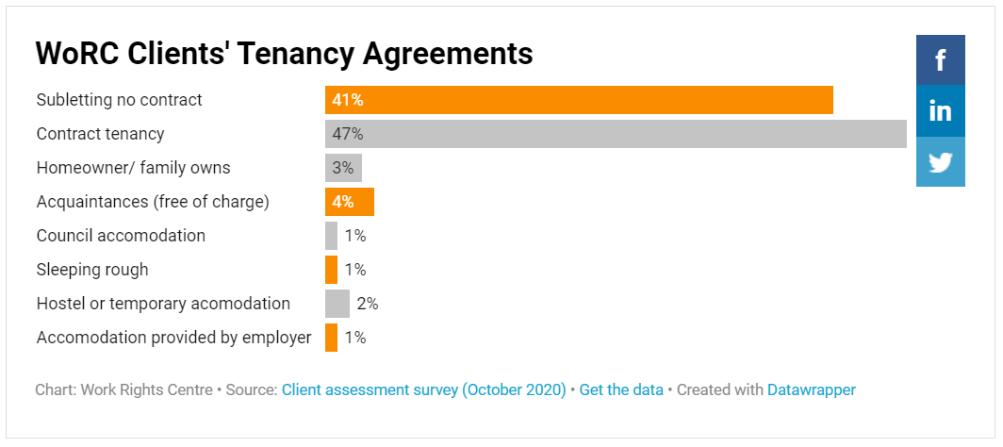
Work Rights Centre

Slide 5
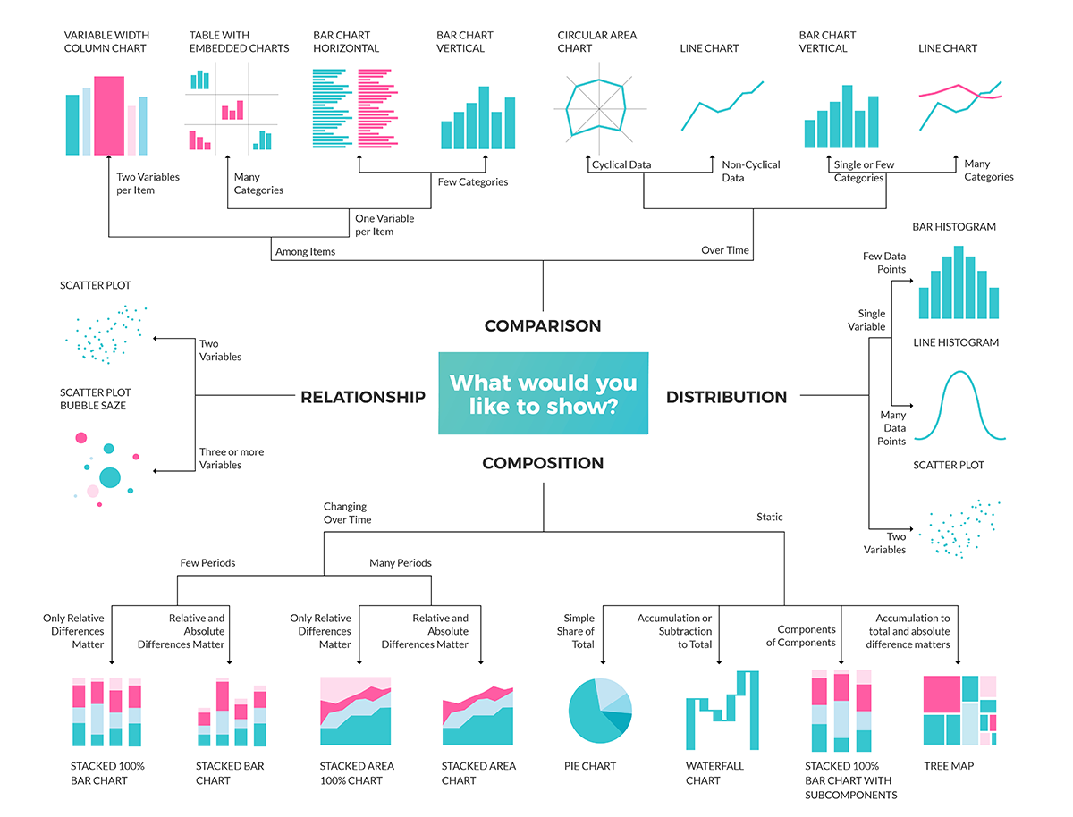

Slide 6
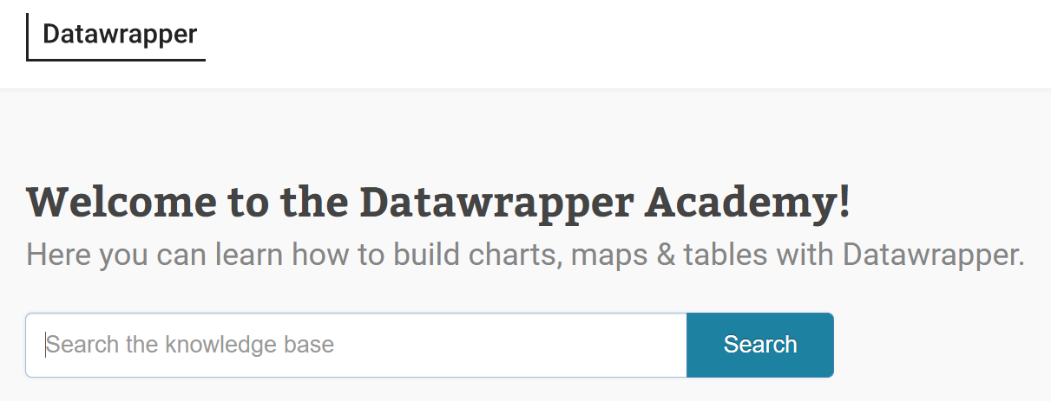
Getting help….
https://academy.datawrapper.de/

