Slide 1
Monitoring & Evaluation framework template
Define your outcomes and how to measure them

Slide 2

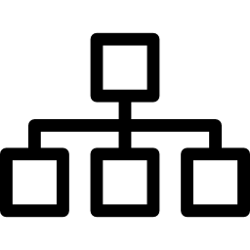
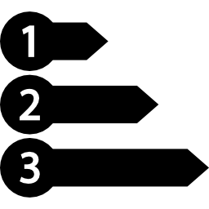


Building an outcomes measurement strategy
Stakeholder consultation
Theory of change
Prioritise outcomes to measure
Choose tools and data sources
Implement measurement framework

Slide 3
Measurement framework example (Armed forces charity)
Outcome | Activity (where get data) | Indicator (how do you know outcome achieved?) | Information collection (how get data) | When and by whom | Reporting (how / where reported)
Increased sense of feeling valued | Veteran events | Number report feeling of self value | Sign-up form and tokens | At every Nth event | % people say they feel more valued
 |  | Number of thank you letters mentioning self value | Letters | Office admin | Short case study
 |  | Posture | Observation | Event organiser | Photos
Better able to cope with experiences, trauma and adjusting to civilian life | Group respite holidays with partners | Number reporting better able to cope | Sign-up form and follow-up survey | At every event | % better able to cope
 |  | Likelihood of talking about experiences with partner | Interviews during holiday | At every event | Regular interval case studies
 |  | Employment status | Sign-up form and follow-up survey | At every event | % in employment
 |  | Number times go out socially each month | Show of hands | Event organiser | % change in social engagement
 | Regional outings and events | Number reporting better able to cope | Interviews | At every Nth event | % better able to cope
 |  | Willingness to participate in [outings] without charity support | Survey | At every Nth event | % change in social activity
 |  | Whether or not people have shared experiences | Interviews | Event organiser | Case study

Slide 4
Measurement framework template
Outcome | Activity (where to get the data) | Indicator (how do you know the outcome is achieved?) | Information collection (how get data) | When and by whom | Reporting (how and where reported)

